Slide 1
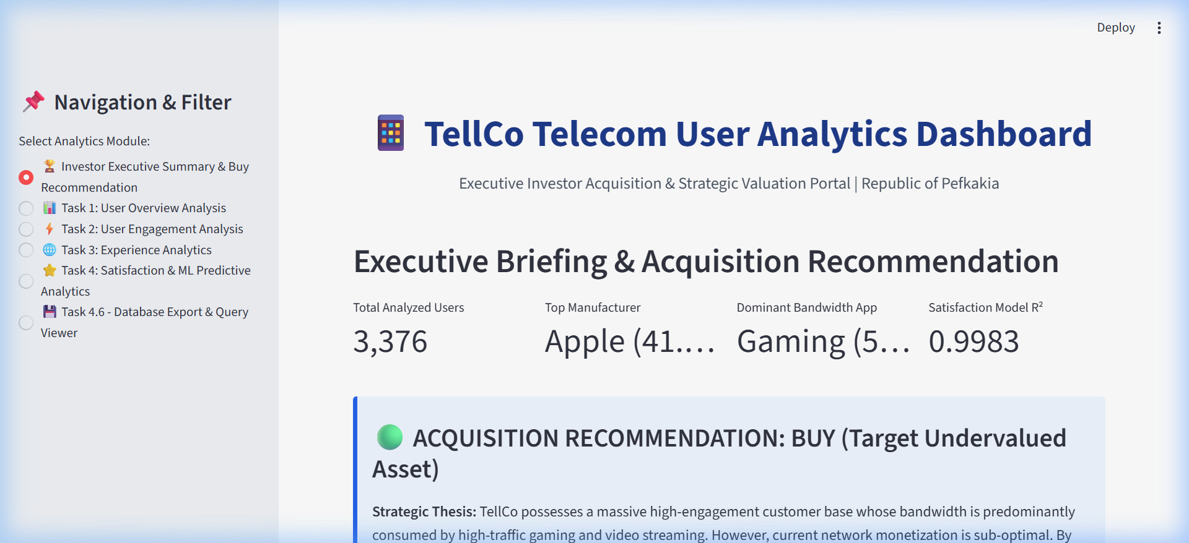
User Analytics in the Telecommunication Industry - Overview

Slide 2
Title: User Analytics in the Telecommunication Industry – Overview
Presented By: Chandani Dhimmar

Slide 3
Introduction
The study focuses on analyzing telecom user data to understand engagement, satisfaction, and handset ecosystem trends. By leveraging SQL queries for structured data extraction and Power BI dashboards for visualization, the project provides actionable insights. These insights are designed to support investor decision-making, highlighting opportunities in acquisition and growth strategies.

Slide 4
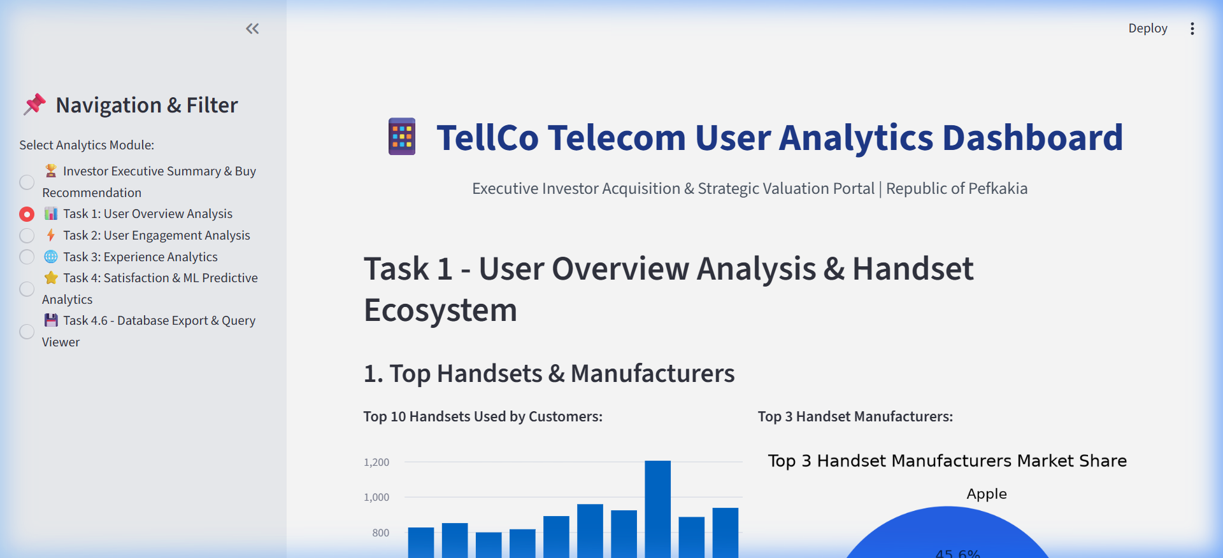
Objectives of the Study
Evaluate handset ecosystem & user engagement: Identify dominant brands, usage patterns, and customer loyalty.
Apply clustering & ML models: Use K-Means clustering and regression analysis to predict satisfaction scores and segment users.
Integrate SQL queries with BI dashboards: Ensure seamless data flow from raw logs to interactive dashboards.
Provide acquisition recommendations: Suggest potential investment opportunities based on analytics-driven evidence.

Slide 5
Scope of the Study
The scope covers user overview, engagement, experience, and satisfaction. Predictive analytics methods (clustering, regression) are applied to uncover hidden patterns. The study is tailored for telecom investors, analysts, and decision-makers, offering both technical depth and strategic insights.

Slide 6
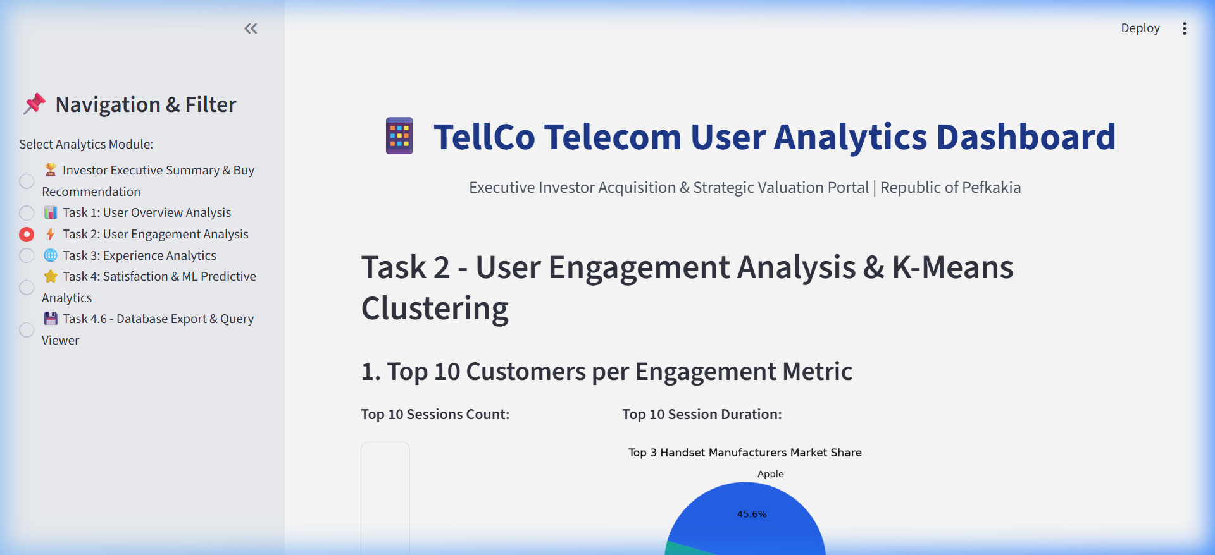
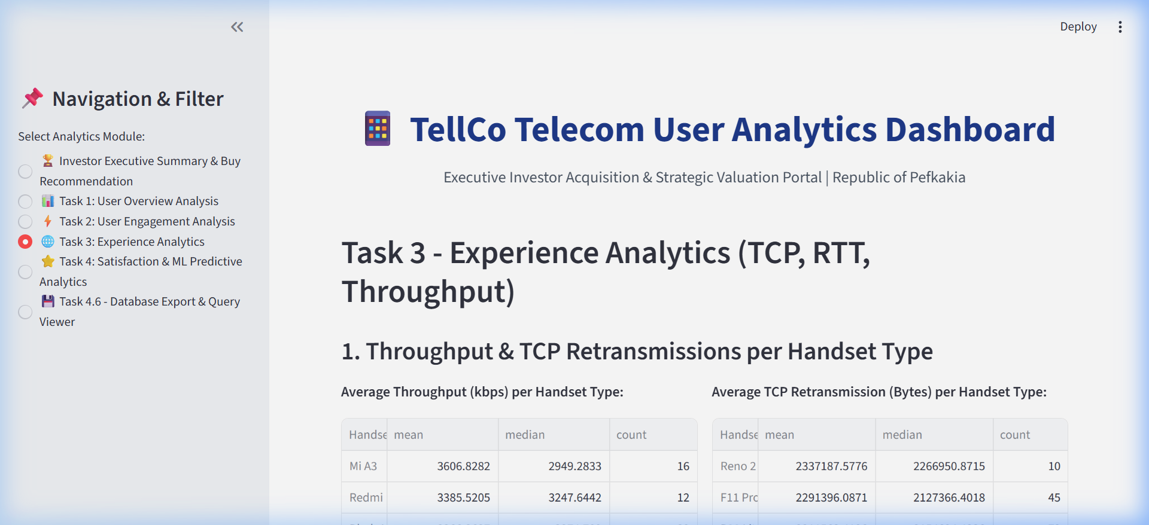
Dataset Snapshot
The dataset includes 100,000+ transactions with 3,376 users analyzed. Data cleaning involved removing duplicates, handling missing values, and structuring tables. Key attributes include handset type, session counts, throughput, and satisfaction scores, forming the foundation for predictive modeling.

Slide 7
Histogram: End to End Work Flow
Data Collection: Telecom logs stored in SQL databases.
Preprocessing: Cleaning, joins, and aggregation to unify datasets.
Feature Extraction: Metrics like handset type, session frequency, and throughput.
ML Modeling: Clustering and regression models applied for satisfaction prediction.
Visualization: Power BI dashboards created for interactive analysis.
Insights & Recommendations: Actionable findings presented to stakeholders.

Slide 8
User Overview Analysis
Apple dominates the handset ecosystem with a 45.6% market share, followed by Samsung and OnePlus. This indicates strong brand loyalty and premium user segments, which can influence acquisition strategies.

Slide 9
User Engagement Analysis
High session counts highlight heavy users, especially in gaming and streaming categories. Clustering segmentation reveals distinct groups:
Heavy users (high engagement, high bandwidth).
Casual users (moderate engagement).
Low users (minimal sessions, low monetization potential).

Slide 10
Experience Analytics
Throughput and TCP retransmission rates vary across handsets. Apple and Samsung show better performance, while some mid-range devices struggle with network optimization, impacting user satisfaction in gaming and streaming.

Slide 11
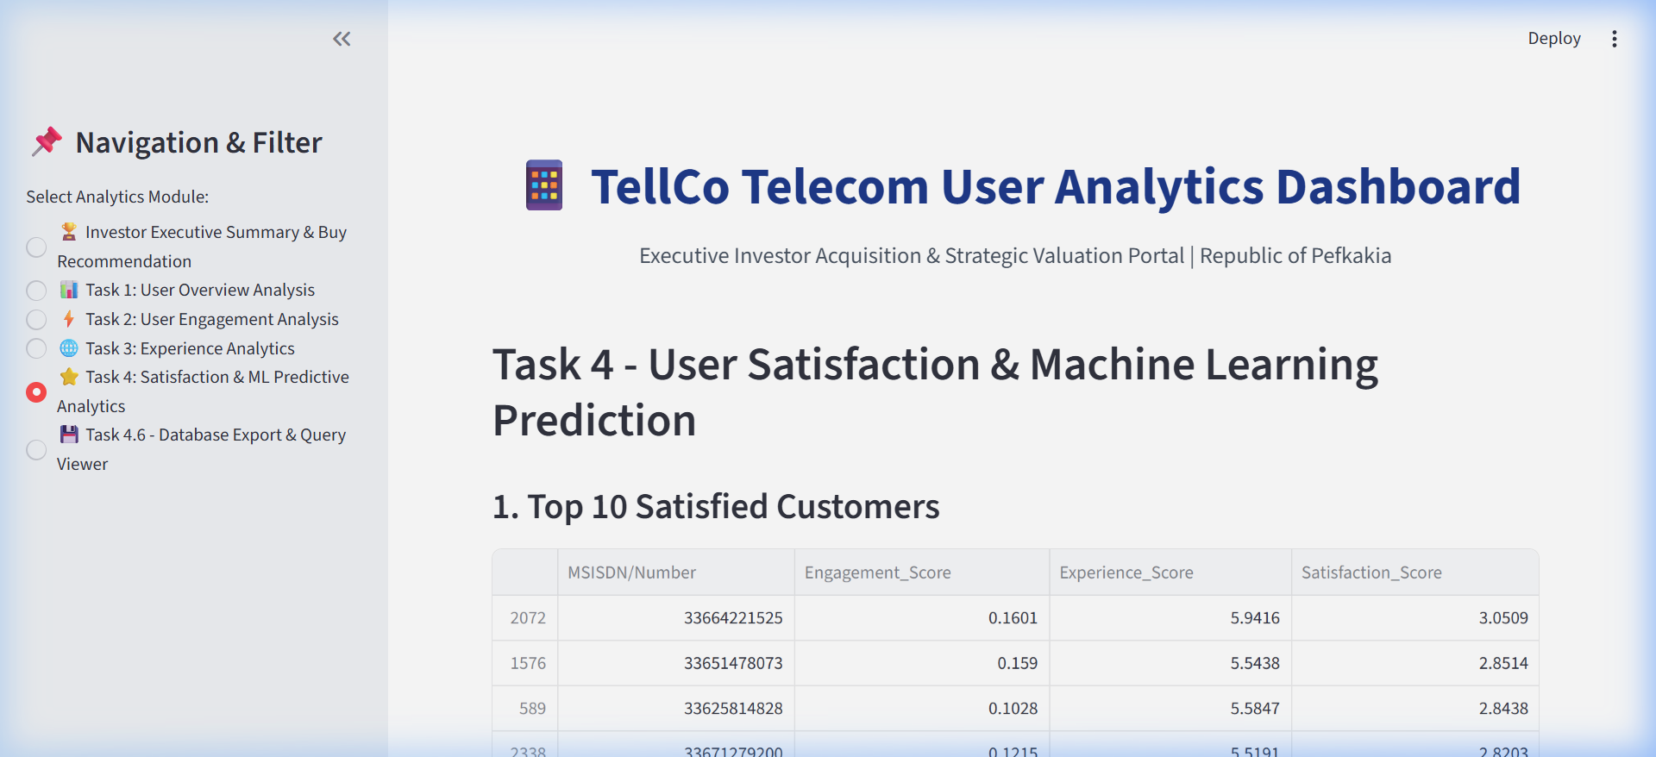
Satisfaction & ML Prediction
The ML model predicts satisfaction clusters with R² ≈ 0.99, indicating strong accuracy. Top satisfied customers align with premium handset users, while dissatisfaction is linked to poor throughput and high retransmissions.

Slide 12
Key Findings
📱 Apple leads handset ecosystem.
🎮 Gaming & streaming dominate bandwidth.
📊 High engagement but low monetization.
🤖 ML model shows strong predictive accuracy (R² ≈ 0.99).

Slide 13
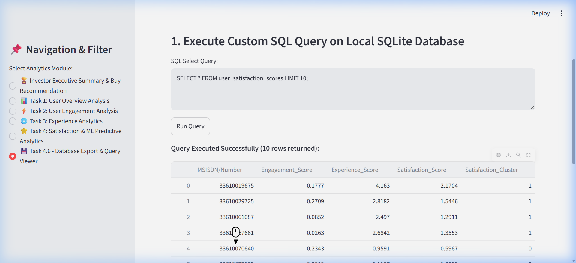
Challenges
Data quality issues during preprocessing.
Integration of SQL queries with BI dashboards.
Model optimization for large-scale deployment.
Constraints in real-time implementation.
.

Slide 14
Conclusion
The integration of SQL and BI tools provides actionable insights into user behavior and satisfaction. The findings present a strong case for acquisition, identifying undervalued telecom assets with high ROI potential. This supports investor decision-making with data-driven evidence.

Slide 15

Thank you
Chandani Dhimmar

